Slide 1
ECLI and Beyond: Improving online access to court decisions
ECLI and creation of other metadata
(References to previous case law cited by the Court of Justice of the EU)
Monika Mazur
Directorate-General for Library, Research and Documentation
Research and Documentation Directorate
Court of Justice of the European Union

Slide 2
R&D Directorate
Part of Library, Research and Documentation General Directorate
40 legal experts
Representation of all MS legal systems
General tasks:
Comparative law expertise
Follow evolution of legal questions (EU & national level)
Legal analysis of the case-law
specific task: analysis of the references to case-law (and legislation)

Slide 3
References to previous case law
Objective:
One of criteria of research in the case law cited in:
the grounds of the judgment or order
the operative part of the judgment or order
the Advocate General’s Opinion
Following the developments in case-law of the Court of Justice
Determining the most important points („golden points”)
Requirements:
CELEX number as metadata for the references in the internal database

Slide 4
Method of citing the case-law
New method of citation applicable to judicial decisions drafted from 1 January 2014
All decisions issued since 1954 have the ECLI number
The method of citing the case-law adopted by the CJEU combines the ECLI with the usual name of the decision and the case number in the register
This method of citation:
improves the accessibility of judicial decisions - the references to the case-law contain, each time they appear, the information necessary to identify the decision referred to, particularly as all the constituent elements of the references are mentioned every time the reference is made
introduce the linguistic neutrality of the format of the citation - identical in all languages (less elements to be translated)
facilitates the automatic insertion of hyperlinks on the ECLI of the decision cited and on the relevant paragraph of that decision

Slide 5
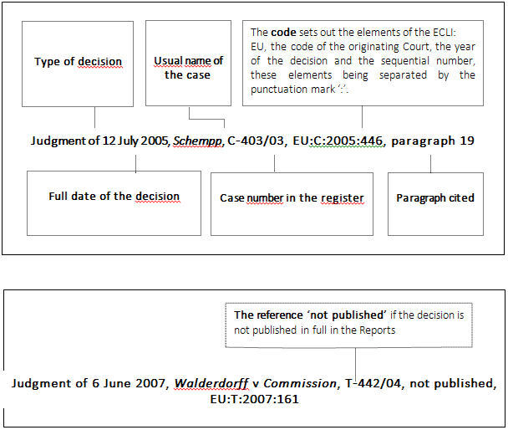
Method of citing the case-law
Elements of the reference:

Slide 6
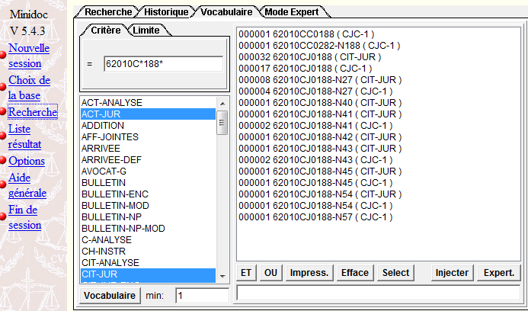
References - Minidoc2 (internal database)

Slide 7
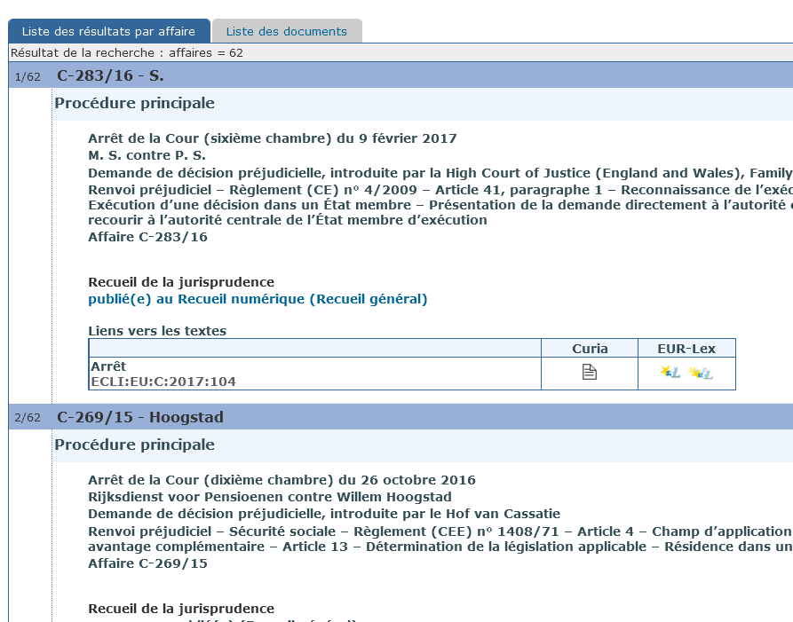
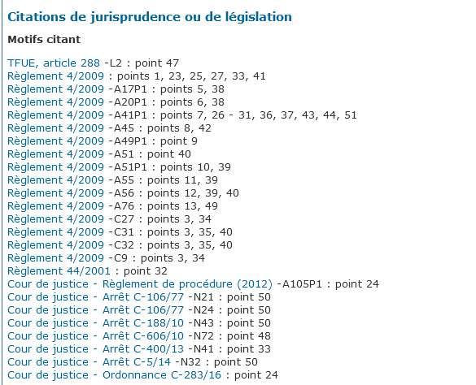
References - InfoCuria (external database)

Slide 8
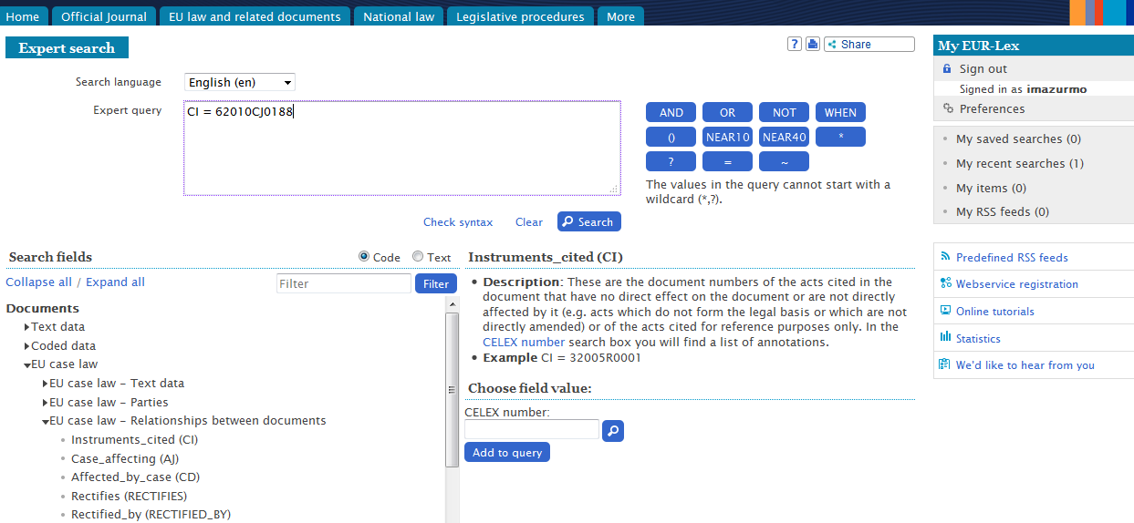
References - EUR-Lex (external database)

Slide 9
Automatic detection of references
Built-in macro in the editing tool (Word) to:
Detect ECLI pattern
Return the corresponding CELEX from the internal database (Litige)
Generate the corresponding reference, according to the internal, linguistically neutral, syntax
reduce workload needed to accomplish this task
These references are then stored, indexed, in order to be used by various search engines
GenDoc
(Word)
Litige Database:
(Case number)
ECLI = CELEX
Macro CITJUR

Slide 10
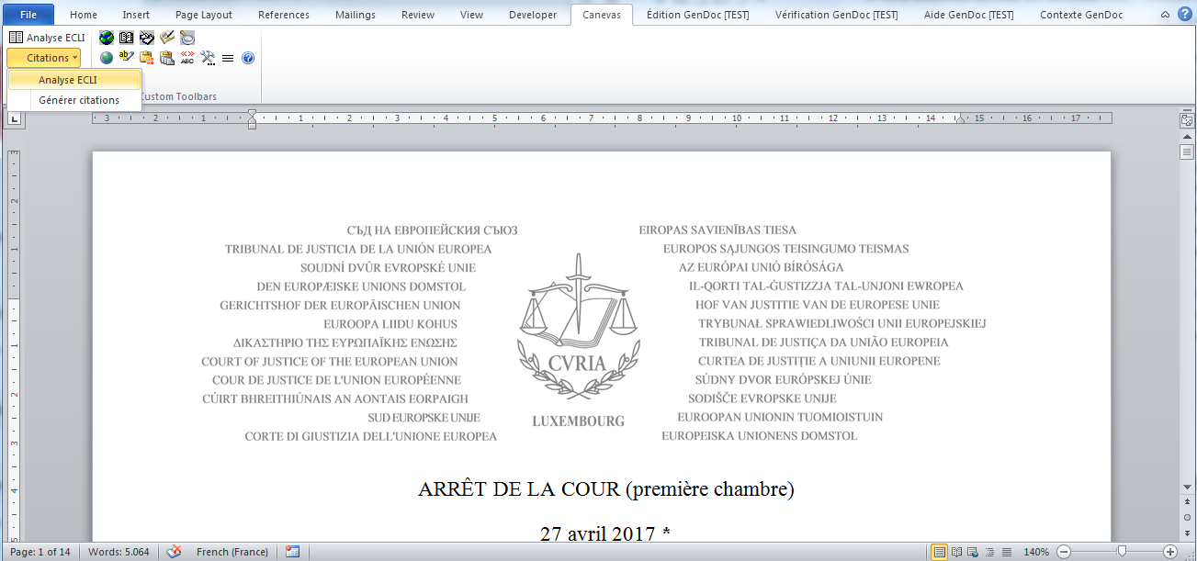
Automatic detection of references

Slide 11
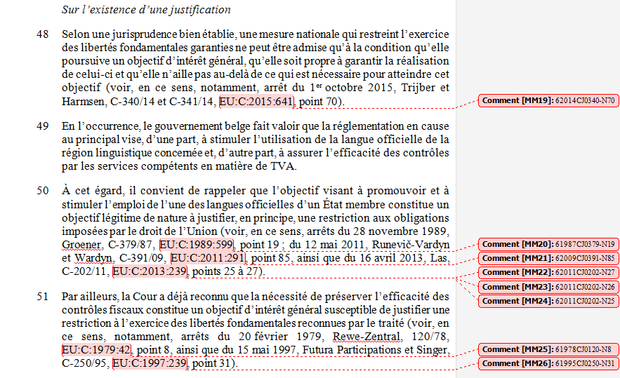
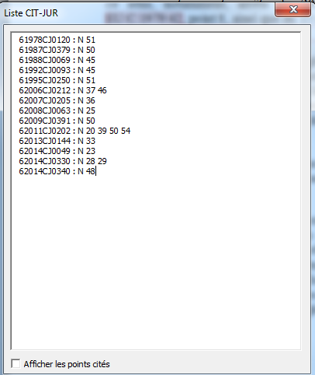
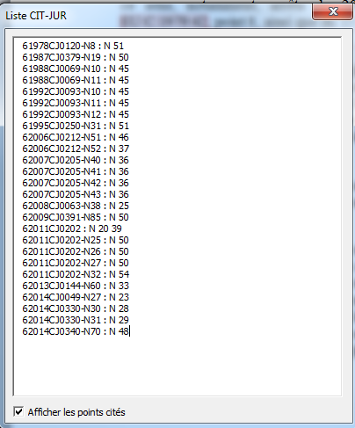
Automatic detection of references

Slide 12
Hyperlink in the digital Reports
Unstructured text with a formal publication reference (ECLI or page in the Official Journal)
Semi-automated transformation
XML with REF.DOC.ECR or REF.DOC.OJ elements
Automated conversion
HTML with hyperlinks to the case/expression/manifestation

Slide 13
Hyperlink in the digital Reports
Semi-automated transformation
Automated conversion

Slide 14
Thank you for your attention

